Slide 1
PlagiaBust - Plagiarism Detection Framework

Slide 2

The Team
Group Members
Project Supervisors
Udana Costa
Nuwan Senevirathna
Isuru Wijesinghe
Kasun Jayasinghe
Dr. Malaka Walpola
Mr. Chulaka Gunasekara

Slide 3
Flow of the Presentation
Background
What is PlagiaBust
Overview of PlagiaBust
Research Conducted
Technologies and Methods
Features
Q & A

Slide 4
Background
Plagiarism is the unauthorized use of the language and the thoughts of another user and the representation of them as one’s own original work without acknowledgement.
Lots of academic institutes are using online submission of assignments, projects, reports.
Availability of Internet materials has made it easy for students to plagiarize from Internet resources.
Academic institutes are keen to prevent students from plagiarizing.

Slide 5
What is PlagiaBust
Free and Open Source plagiarism detection framework
Plagiarism detection for a single document
Plagiarism detection for a set of peer documents
Detection of Internet Plagiarism
Document server to reduce the time taken to download Internet documents
Graphical representation of plagiarism results using
Comparison window
Graphs
Internet source browser
Comprehensive final report

Slide 6
In a Nutshell
PlagiaBust is a tool for,
Detecting plagiarism in documents using both Internet plagiarism detection techniques and peer document plagiarism detection techniques and represent the results using a dynamic visualization component.

Slide 7
Overview of the PlagiaBust System
Data Extraction Module
Data Preprocessing Module
Matching Engine
Global Source Detection Module
Reporting Generator Module
Storage Interface
Storage

Slide 8
Research Conducted
Global Source Detection
Query Selection Algorithms – Using Plagiabust Testing Framework
Exhaustive selection
Flesch-Kincaid Grade Level
Random selection
Paragraph wise query selection
Internet Search
Querying using Bing search
Querying using Google search
PlagiaBust Web Search Service
Apache Solr

Slide 9
Research Conducted
Data Preprocessing
Stemming Algorithms
Martin Porters Algorithm
Lovins Algorithm
Stop Words Removal
Apache Lucene StopAnalyzer
Apache Lucene SnowballAnalyzer
Synonym Replacement
WordNet - lexical database for the English language
JWNL (Java WordNet Library)
JWI (MIT Java Interface to Wordnet)
Lucene – WordNet (Apache lucene team)

Slide 10
Research Conducted
Matching Engine
Copy-Paste Detection
Cosine Similarity
Euclidean Distance
Greedy String Tiling Algorithm
ShingleCloud Approach
Paraphrase Detection
Text Semantic Similarity Calculation
Recognition Approaches uses Surface Text Similarity
Recognition Approaches Based on Syntactic Similarity
Recognition Approaches that Employ Machine Learning

Slide 11
Technologies and Methods Used
Document Type Support
Convert all document formats into text format
(pdf, doc, docx, rtf, txt)
PDF - Apache PDF Box version 0.7.3
Docx, Doc - Apache POI 3.7
Data Preprocessing
Stemming – Porter Stemming Algorithm
Stop Word Removal – Apache Lucene Stop Analyzer
Synonym Replacement – Apache Lucene Wordnet

Slide 12
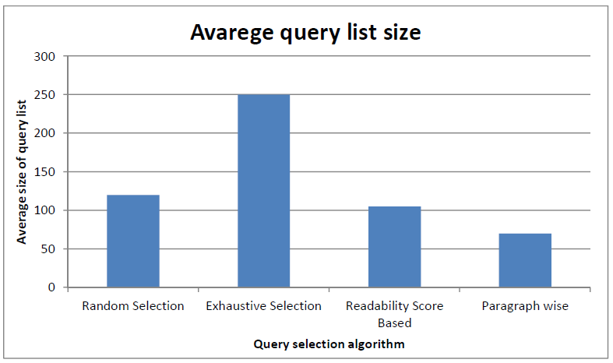
Technologies and Methods Used
Query Selection Algorithm
Paragraph wise query selection
Testing Corpus - set of 100 documents, each contain approximately 3000 words

Slide 13
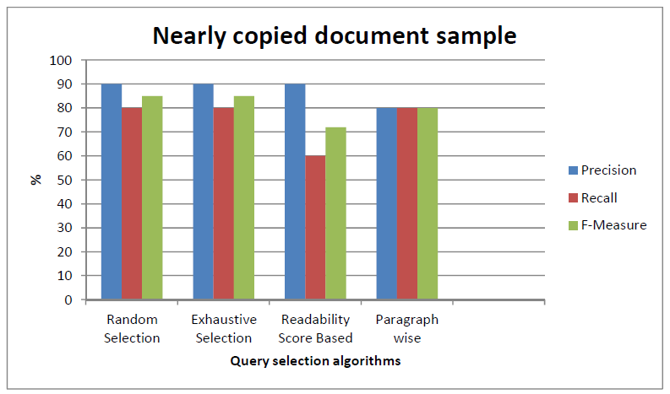
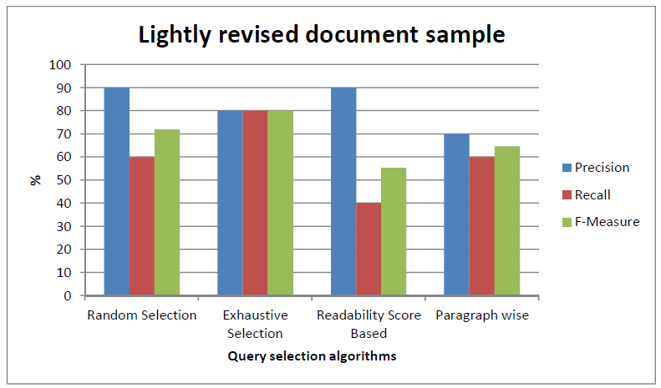
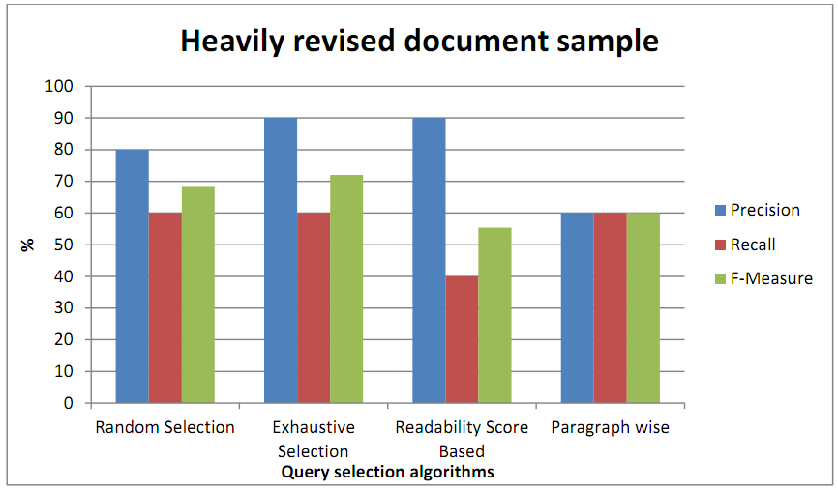
Technologies and Methods Used

Slide 14
Technologies and Methods Used
Internet Live Search Services – Bing Search API, Google Search API
Peer Document Filtering – using Apache Lucene 2.9
Narrow down the document search space
PlagiaBust Web Search Service – using Apache Solr
An alternative for Internet Search Services

Slide 15
Technologies and Methods Used
Textual Similarity Comparison
Comparison Algorithm - ShingleCloud Approach
Document Chunking – n-gram Chunking
Size of a N-Gram
Minimal number of ones in a match
Maximum number of zeros in a match

Slide 16
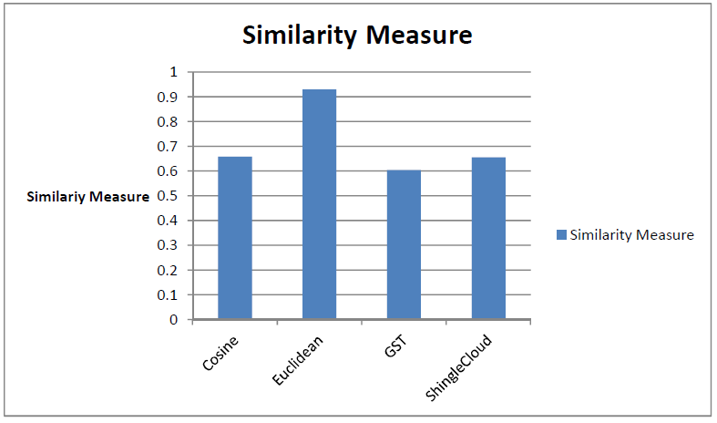
Technologies and Methods Used
Textual Similarity Algorithms Comparison

Slide 17
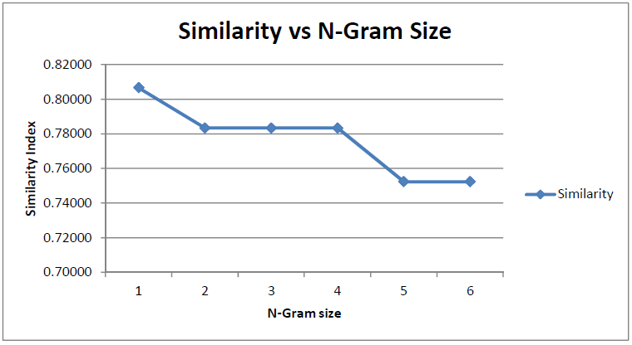
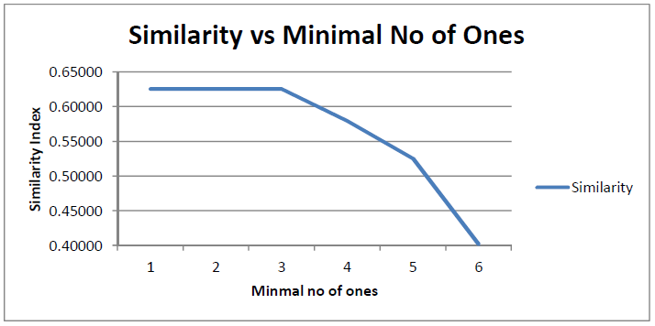
Technologies and Methods Used
ShingleCloud Algorithm Input Parameters Selection

Slide 18
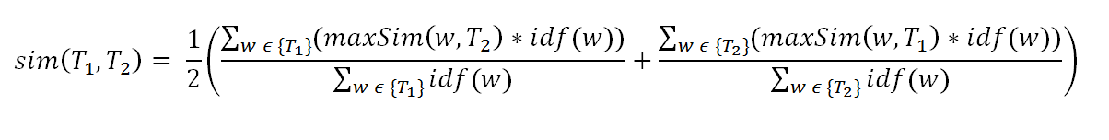
Technologies and Methods Used
Paraphrase Detection
Algorithm– Sementic Similarity calculation
Testing Corpus - Microsoft Research Paraphrase Corpus
contains 5801 pairs of sentences obtained from online news articles referring to same event
approximately 67% of the 5,801 pairs were judged to be paraphrases.

Slide 19
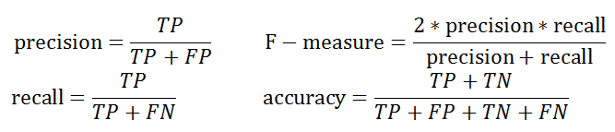
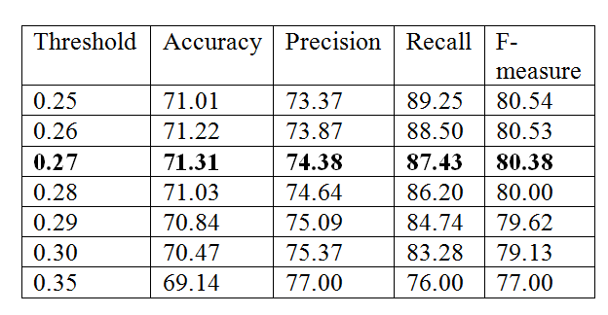
Technologies and Methods Used
Paraphrase Detection
Accuracy Measures
Threshold value selection

Slide 20
Technologies and Methods Used
Comparison with available methods
Method | Accuracy (%) | Precision (%) | Recall (%) | F-measure (%)
Corley &Mihalcea (2005)[1] | 71.5 | 72.3 | 92.5 | 81.2
Das & Smith (2009)[2] | 76.1 | 79.6 | 86.1 | 82.9
Finch et al. (2005)[3] | 75.0 | 76.6 | 89.8 | 82.7
Malakasiotis (2009)[4] | 76.2 | 79.4 | 86.8 | 82.9
Qiu et al. (2006)[5] | 72.0 | 72.5 | 93.4 | 81.6
Wan et al. (2006)[6] | 75.6 | 77.0 | 90.0 | 83.0
Zhang & Patrick (2005)[7] | 71.9 | 74.3 | 88.2 | 80.7
Our Method | 71.31 | 74.38 | 87.43 | 80.38
BASE1 | 66.5 | 66.5 | 100.0 | 79.9
BASE2 | 69.0 | 72.4 | 86.3 | 78.8

Slide 21
Technologies and Methods Used
Reporting Module
Java Swing Framework
Final Report - Jasper Reports Java library
Exporting capability to Pdf,Doc,HTML etc.
Connected Graph View of the Plagiarism Results - JUNG graph plotting library
Vertices- Documents
Edges- The connection between documents-
Text Highlighting – Java Highlighter, Regular Expressions

Slide 22
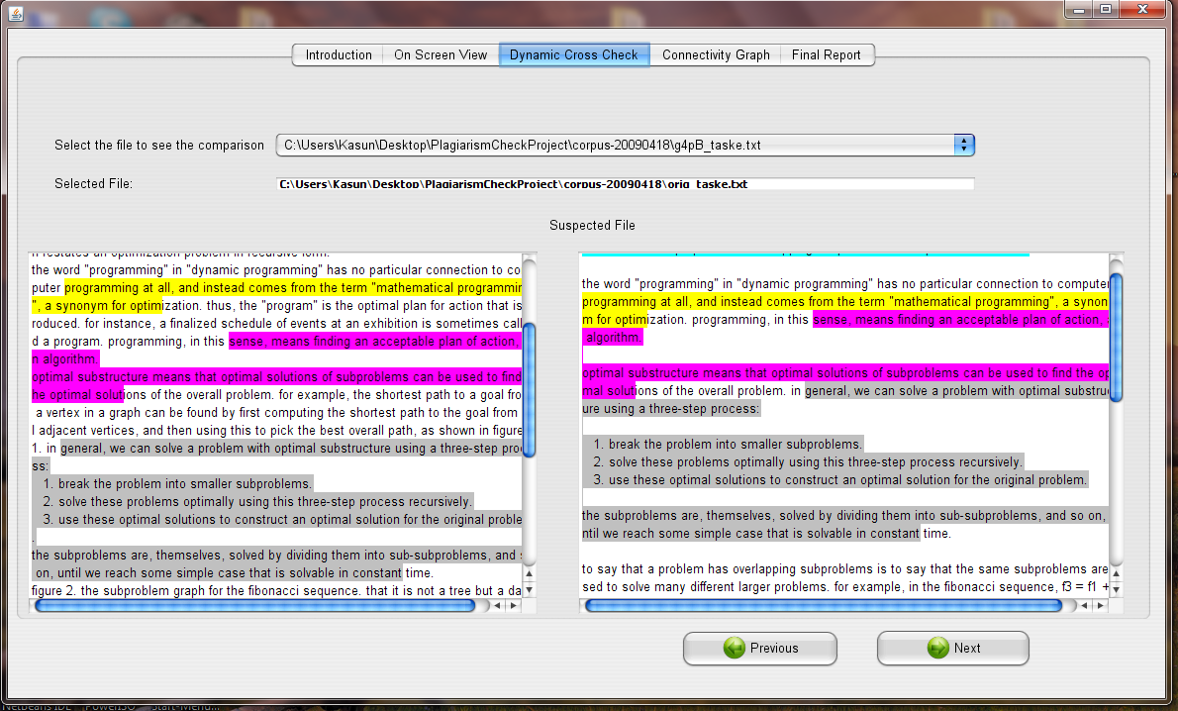
Core Features
Document comparison window

Slide 23
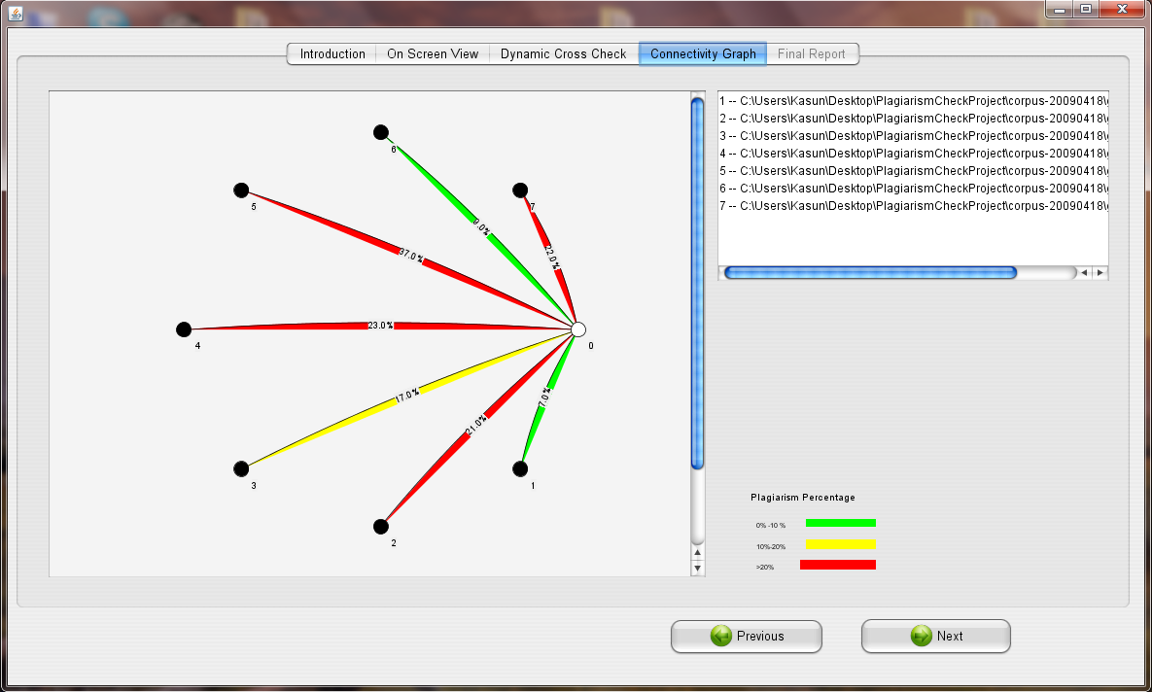
Core Features
Connectivity Graph

Slide 24
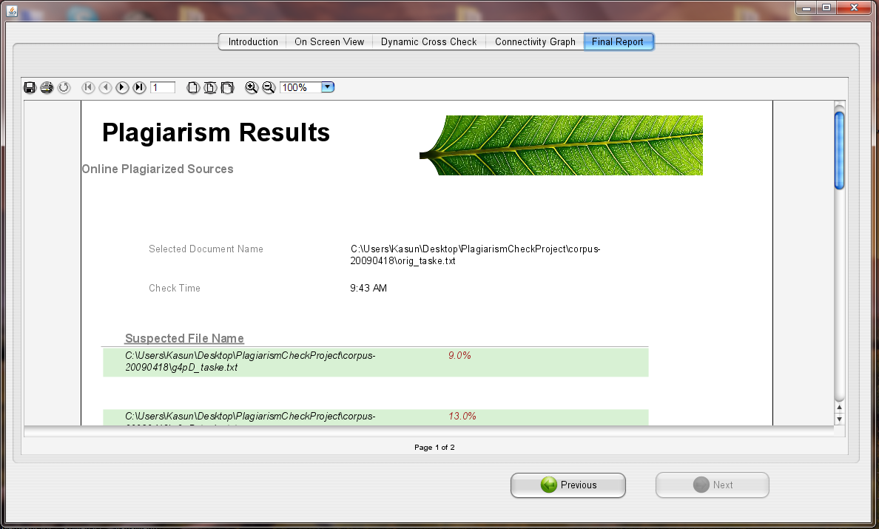
Core Features
Plagiarism Report

Slide 25
Q & A

Slide 26
Thank You

